Slide 1
Remaining Air Component
Nitrogen gas
Air
Air Preparation
(Dehydration, Filtration)
Pressure
Swing
Absorption
Reactor Feed
Preparation
Water
Water Purifier
Electrolyzer
Gas Purification
Hydrogen gas
Water,
Oxygen gas

Slide 2
Plasma Source
Ammonia
Gas
Liquid
Ammonia
NTP
Reactor
Separation
Compressor
Recycle
Ammonia Synthesis
Reactor
Liquid
Ammonia
Absorber
Recycle

Slide 3
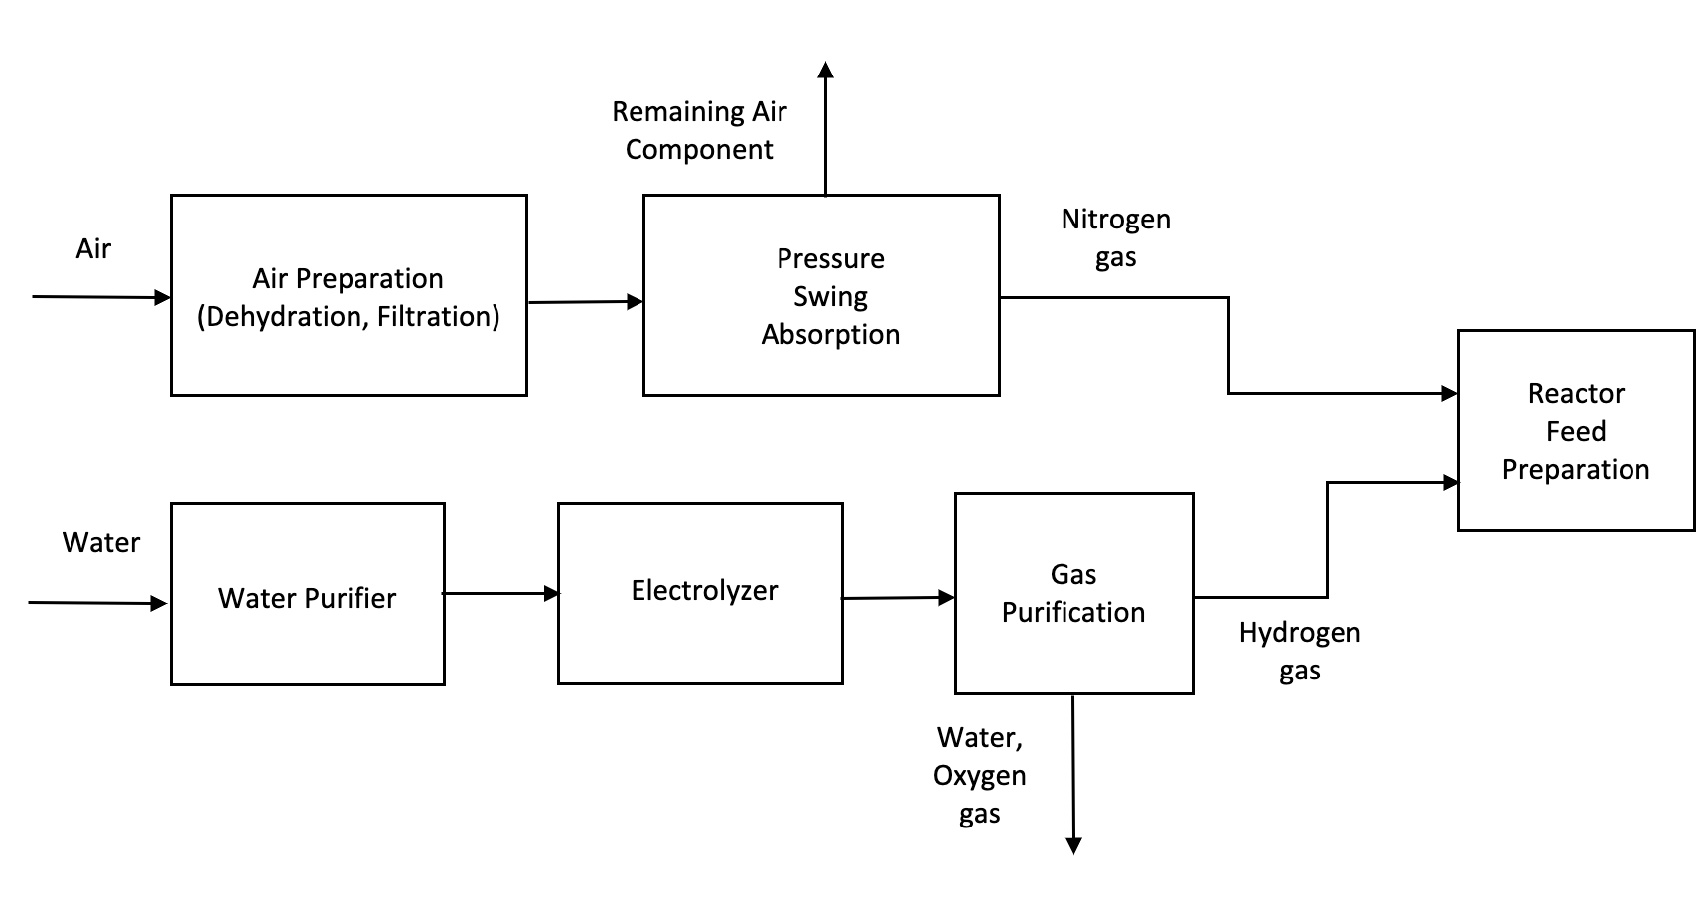
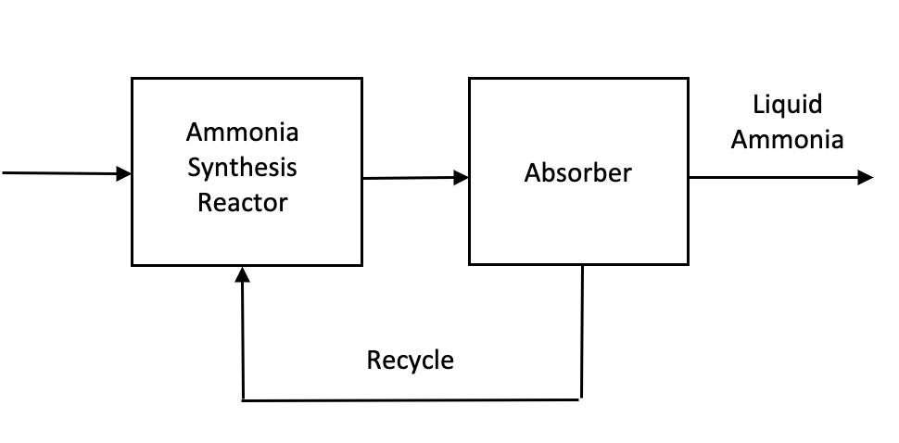
3.25 kmol/hr
104 kg/hr
15.5 kmol/hr
447 kg/hr
24.5 kmol/hr
417 kg/hr
36.75 kmol/hr
661.5 kg/hr
18.375 kmol/hr
588 kg/hr

